Slide 1
BUILD BIG DATA ENTERPRISE SOLUTIONS FASTER ON AZURE HDINSIGHT
Pranav Rastogi
Microsoft
@rustd

Slide 2
Agenda
Azure HDInsight Overview
HDInsight Application Platform
Big data solutions

Slide 3





Big data is hard
Success
Buy
Servers
Install
OSS
Secure
Configure
Optimize
Debug
Scale up

Slide 4


HDInsight makes it easy
100% open source
Optimized
Highly available
Secure
Scalable
Dedicated
Managed
Certified ISVs
Customizable
Browse to
Azure Portal
Provide
Cluster
details
HDInsight
Cluster

Slide 5






Open Source for the Enterprise
Managed Open Source Analytics for the cloud with a 99.9% SLA.
100% Open Source
Clusters up and running in minutes
63% lower TCO than deploy your own Hadoop on-premises
Separation of compute and store allows you to scale clusters to exponentially reduce costs

Slide 6
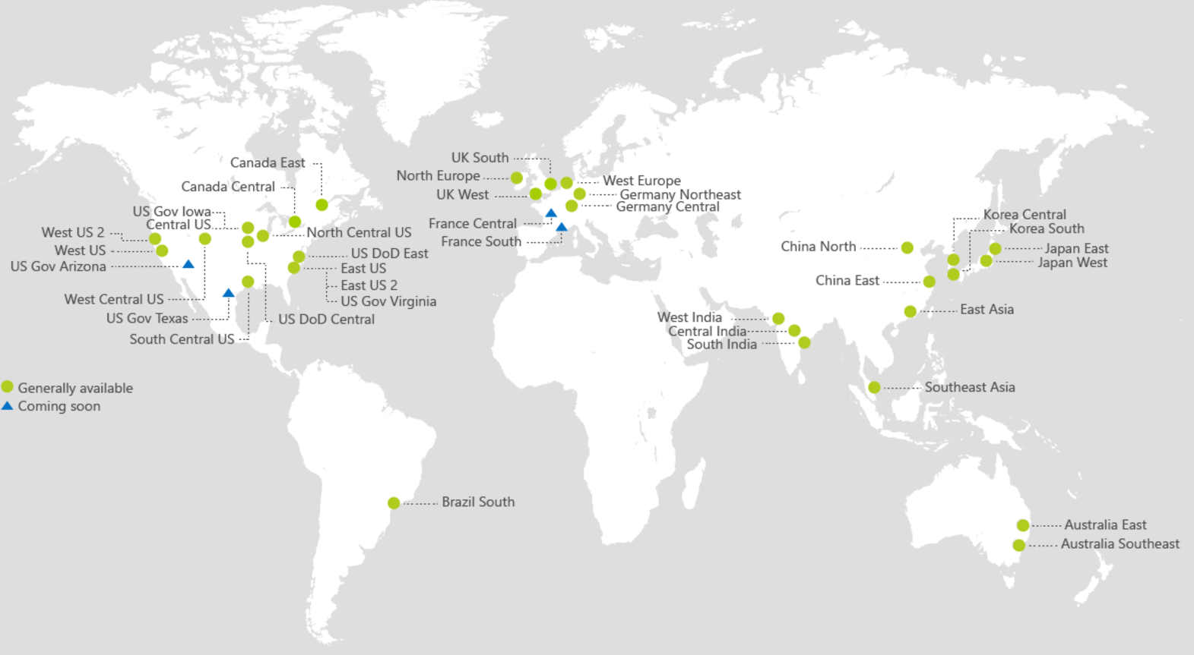
Deploy Globally Within Minutes
Multi Region Availability
Available in >25 regions world-wide
Launched most recently in US West 2, and UK regions
Available in China, Europe and US Government clouds

Slide 7





Security and Compliance to Enable OSS for Enterprises
Authentication
Azure Active Directory
Kerberos authentication
Perimeter Level Security
Virtual Networks
Network Security Groups (firewalls)
Authorization
Apache Ranger
RBAC for Admin
POSIX ACLs for Data Plane
Data Security
Server-Side encryption at rest
HTTPS/TLS In-transit

Slide 8






Rich Developer Ecosystem
Plugins for HDI available for most popular IDEs for agile development and debugging
Rich support for powerful notebooks used by data scientists
Develop in C#, deploy on Linux in Java via HDI developed SCP.Net technology

Slide 9

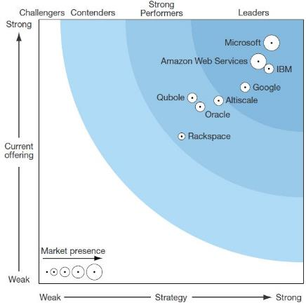
Recognized by Top Analysts
Forrester Wave for Big Data Hadoop Cloud
Named industry leader by Forrester with the most comprehensive, scalable, and integrated platforms*
Recognized for its cloud-first strategy that is paying off*
*The Forrester WaveTM: Big Data Hadoop Cloud Solutions, Q2 2016.

Slide 10
HDInsight Application Platform
1-click deploy experience for apps

Slide 11
HDInsight Application Platform
Discover and install apps from ecosystem
One-click deploy experience
Access to entire cluster and secure by default
Install apps on new or existing clusters
Ease of authoring and deployment for ISV’s

Slide 12





HDInsight architecture
Worker
nodes
Hive meta store
Azure SQL database
Gateway
nodes
Azure Storage or
Data Lake Store
Head
nodes
Client
machines
Edge
nodes
Zookeeper nodes
HDInsight cluster

Slide 13
StreamSets – Conquer dataflow chaos

Slide 14
Why StreamSets
Data Movement from disparate sources
KPI’s on data transfer
Manage Data drift (unexpected changes) at scale.
Run at enterprise grade & scale on HDInsight

Slide 15
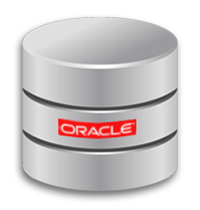



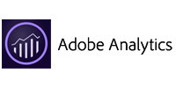


Deep Integration with Microsoft Azure
STREAMSETS DATA COLLECTOR
Information Management
Big Data Stores
Machine Learning and Analytics
Intelligence
Data Sources
People
*
Data Lake Store
Machine Learning
Cognitive Services
Data Lake Store
Data Catalog
SQL Data
Warehouse
Data Lake Analytics
Bot Framework
Web
Apps
*
HDInsight
(Hadoop and Spark)
Event Hubs
Cortana
Mobile
*
Apps
Kafka for
HDInsight
Stream Analytics
Bots
Dashboards & Visualizations
Sensors and devices
*
Power BI
Automated Systems
Data
Intelligence
Action
*

Slide 16
Datameer: Self-Service Data prep/ analytics

Slide 17
Why Datameer
Self-service data prep/ analytics for non - Hadoop users
No Hadoop expertise required
Ease to use excel-like interface for analysts
Run at enterprise grade & scale on HDInsight

Slide 18
AtScale (OLAP on Hadoop)
No data movement

Slide 19
Why AtScale
No data movement for BI scenarios
Use any BI tool
Scale out OLAP with Hadoop & Spark
No Hadoop/ Spark expertise required
Target audience: Analysts
Run at enterprise grade & scale on HDInsight

Slide 20
Dataiku – Data science at Enterprise grade scale

Slide 21
Why Dataiku
Collaborative data science experience
Single tool for data scientists/ beginner analyst
data ingestion (all data types, sizes, format etc.), data preparation, data processing, machine learning, visualization and operationalizing the solution.
Run at enterprise grade & scale on HDInsight

Slide 22
H2O.ai– Deep learning at Enterprise grade scale

Slide 23
Why
Open Source deep learning platform
Run at enterprise grade & scale on HDInsight

Slide 24
Cask – Unified Platform for Big data

Slide 25





Cask and Microsoft:
Enabling Customers’ Journey from Data Ingestion to Action
Ingest, explore &
serve data
Enable governed
self-service
Capture, track and
analyze (meta)data
Develop, test, debug
& deploy apps
Information Management
Big Data Stores
Machine Learning and Analytics
Intelligence
Data Sources
People
Data Factory
Data Lake Store
Machine Learning
Cognitive Services
Data Catalog
SQL Data
Warehouse
Data Lake Analytics
Bot Framework
Web
Apps
HDInsight
(Hadoop and Spark)
Event Hubs
Cortana
Apps
Mobile
Stream Analytics
Bots
Dashboards & Visualizations
Sensors and devices
Power BI
Automated Systems
Data
Intelligence
Action

Slide 26
Azure HDInsight Big Data made easy
Analytics on any data, any size
Easier and more productive for all users
Enterprise-ready

Slide 27
Resources
Azure HDInsight application platform
Install custom HDInsight applications
Try SDC from StreamSets on HDInsight
Try Datameer on HDInsight
Try AtScale on HDInsight
Try DSS from Dataiku on HDInsight
Try H2O.ai on HDInsight
Try CDAP from Cask on HDInsight

Slide 28
Thank You
Pranav Rastogi
Microsoft
@rustd

